Slide 1

RUNGTA COLLEGE OF DENTAL SCIENCES & RESEARCH
TITLE OF THE TOPIC: STERILIZATION AND DISINFECTION
DEPARTMENT OF CONSERVATIVE DENTISTRY AND ENDODONTICS

Slide 2
Specific learning Objectives
At the end of this presentation the learner is expected to know ;
Core areas* | Domain ** | Category #
ANATOMY OF PERIAPEX CEMENTUM PERIODOTAL LIGAMENT INGLES CLASSIFICATION ZONES OF FISH | COGNITIVE | MUST KNOW
PATHWAY OF ENTRY OF MICROORGANISMS IN TOOTH | PSYCHOMOTOR | NICE TO KNOW
DIAGNOSIS OF PERIAPICAL TISSUE ENDO PERIO LESSIONS | AFFECTIVE | DESIRE TO KNOW

Slide 3
Content REMOVAL OF MASK ORDER OF REMOVAL Guidelines

Slide 4
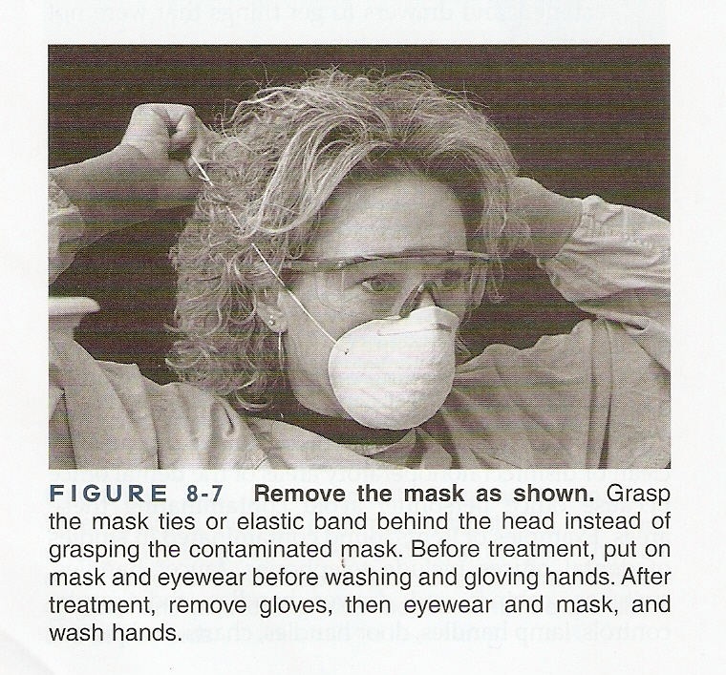
REMOVAL OF MASK
Mask should be removed by grasping the string at the side or back of the head. Avoid handling the body of the mask.

Slide 5
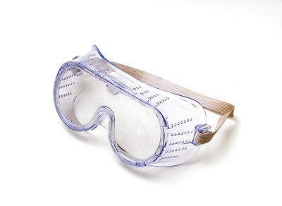
PROTECTIVE EYE WEAR
Protects mucous membrane of the eyes
Glasses with side shields
Eye wear should be grasped by temple pieces
PLASTIC SHIELDS
Clear plastic shields should be used for heavy spatter
HAIR PROTECTION
Hair should be kept out of operating field
Hair can trap heavy contamination

Slide 6
PROTECTIVE OVER GARMENTS
Garments with high neck and long sleeves are adequate to protect skin and prevent soiling of the clothing during procedure
Sleeves with knit cuffs that tuck under the gloves are preferred
Used over garments are removed and placed directly into a laundry bag with a minimum of handling or sorting before leaving the clinical area.

Slide 7
PLACING AND REMOVING BARRIERS
Put protective covering.
↓
Put mask and eyewear.
↓
Unpack instruments and arrange them without direct contact with them.
Just before performing treatment wash hand ,rinse and dry hands and put gloves @ start treatment.

Slide 8
ORDER OF REMOVAL
Disposable gown
↓
Gloves
↓
Protective eyewear
↓
mask

Slide 9
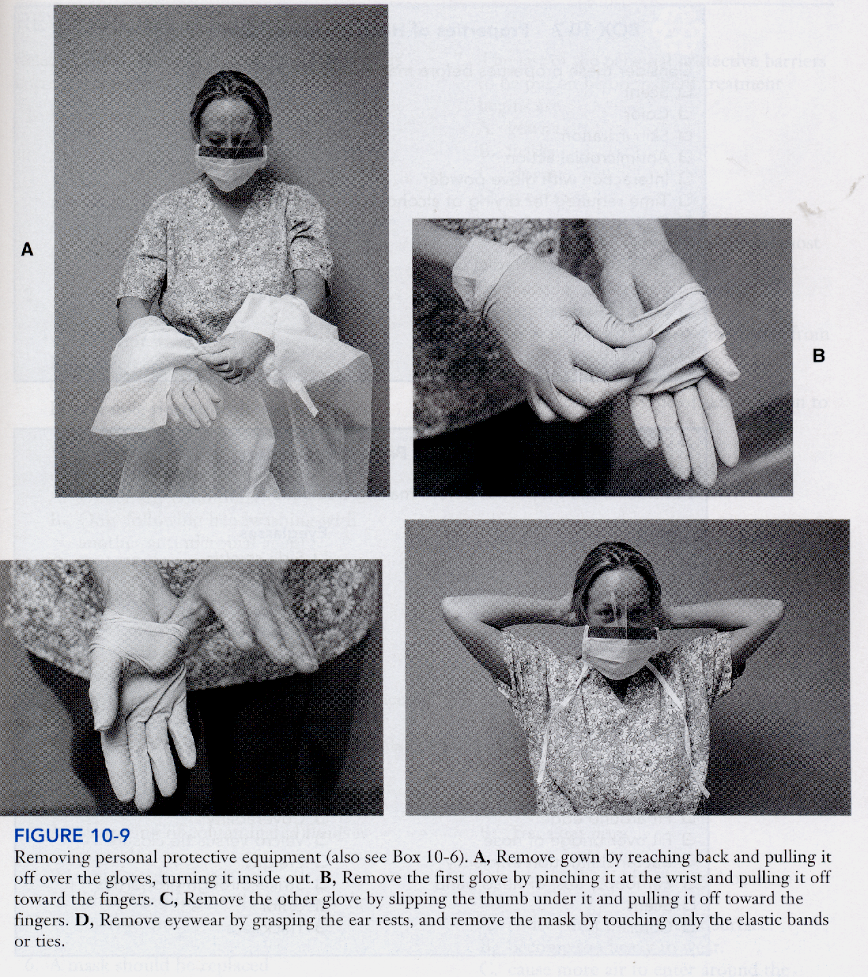

Slide 10
OPERATORY SURFACES
Barrier protection to operatory surfaces is with disposable covers
Impervious paper, aluminium foil or plastic covers can be used.

Slide 11
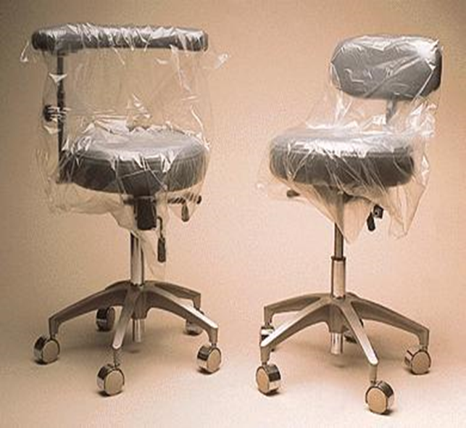
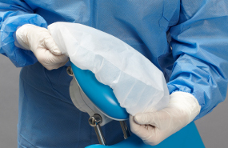

Slide 12
Protect surfaces and equipment that are not sterilized, with disposable single use covers.
For dental unit trays, paper, plastic film or surgical wraps should cover the entire tray including the edges.
Changing covers eliminates cleaning and disinfecting the surfaces, saves time, effort, expense and can be more protective.
Use paper towels, tongs, foil wraps or over gloves to handle equipment briefly or to open cabinets.
With treatment soiled gloves avoid unnecessary contact with operatory surfaces

Slide 13
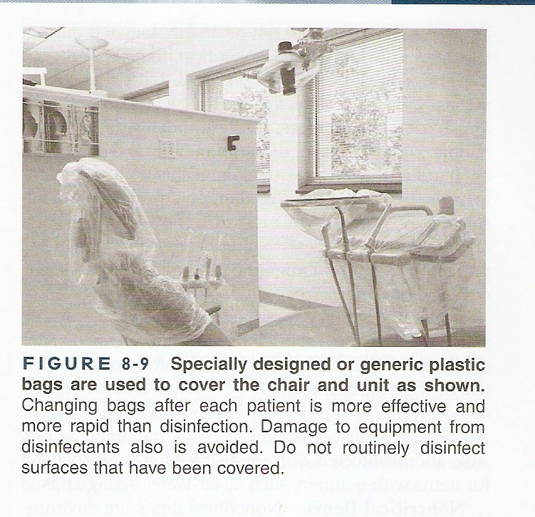
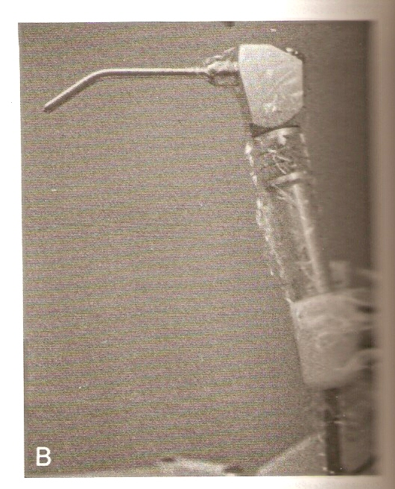

Slide 14
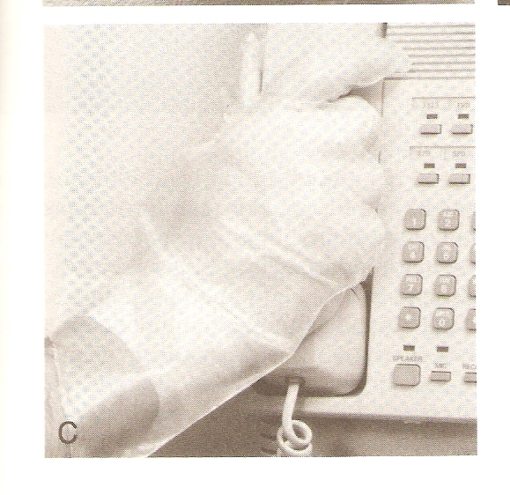
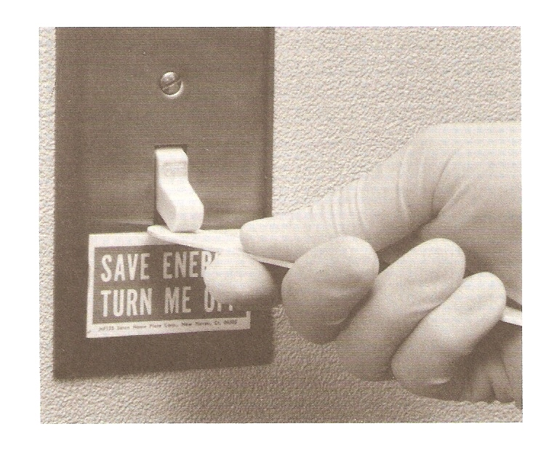

Slide 15
DENTAL WATER DELIVERY SYSTEMS
Dental water delivery systems that are fitted with anti-retraction valves should be used.
Microorganisms that retracted up into the handpiece or water spray hose can be transmitted in the aerosol when the handpiece or water spray is used.
ADA specification No 47 states that the handpiece should not retract more than 2.032cm back onto the handpiece to minimize cross-contamination between patients

Slide 16
WATER AND VACCUM LINES
Microbes exist in dental unit water lines as a free-floating bacteria or as sessile form known as a bio-film
Counts of bacteria that are shed from the biofilms into water of dental unit range from thousands to hundreds of thousands of bacteria per millilitre
The main inhabitants are atypical mycobacteria, pseudomonas and possibly legionella bacteria which can present an infection risk to immunocompromised individuals

Slide 17
Guidelines
All waterlines for syringes and\or hand pieces should be turned on and flushed for several minutes once with the handpieces disconnected, then with connected handpieces at the beginning of the day and 20-30 sec between patients.
All vaccum lines must be flushed by accepted antiseptic solution after every patient procedure to prevent drying to prevent of blood and debris in the lines.
The handpiece always must be removed before disinfecting the system because 0.5% sodium hypochlorite and other strong chemicals would damage the high speed handpiece or other metal products.

Slide 18
CHEMICAL BARRIERS
Use of a mouthwash can reduce bacterial count in generated aerosols by 98%.
Brushing reduces the bacterial count in aerosols by 90%.
Chlorhexidine gluconate (0.12%) rinses result in a prolonged suppression of oral microorganisms over a 5 hour period

Slide 19
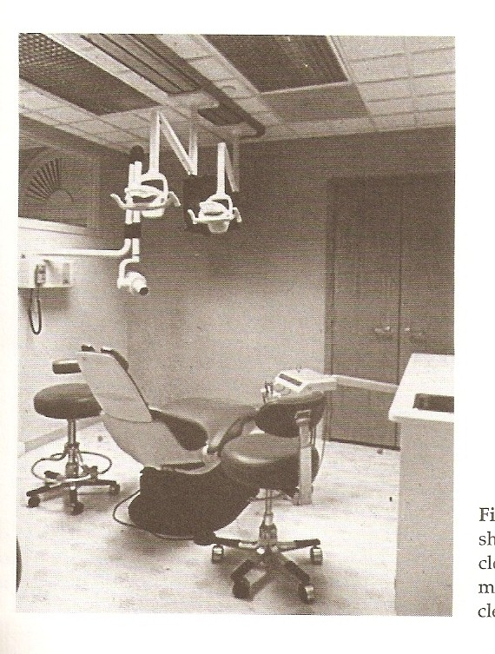
INFECTION CONTROL CONSIDERATIONS IN DENTAL OFFICE DESIGN

Slide 20
OFFICE FLOW
The layout of the office should incorporate a smooth, efficient operational flow.
Patient should have a direct access to the treatment rooms and consultation areas from the reception area
The size most typical ideal treatment room size is optimized at 10x91\2 feet with dual entrances to ease traffic flow.
Treatment room cabinetry should be positioned on both sides of patients chair
Positioning two sinks in each treatment room with in the patients view allows maximum doctor or assistant access.
The treatment area must be separated from the treatment support area.

Slide 21
INSTRUMENT RECIRCULATION AREA
It must include a total of 18- 24 linear feet of cabinetry
The IRC should be divided into four stations:
Pre-cleaning
Drying, sorting, inspection and packaging.
Sterilization
Storage and dispensing
The cabinetry should be constructed of a smooth non-porous material such as stainless steel, resin laminates or ideally a special processed resin known as melamine.
Storage areas should be covered with a smooth surface see through cabinet doors.

Slide 22
Cabinetry surfaces, wall and floor coverings
Wood surfaces, heavily textured wall coverings and fabrics for decoration should be eliminated. Floor coverings such as high-pile carpets should never be used because they are not compatible with aseptic maintenance.
Smooth, seamless, non-porous materials are recomended. Ideally seamless continuous roll of hard vinyl floor coverings or low pile tightly woven synthetic fibre carpet with an anti-microbial agent should be used.
Resin laminates, stainless steel or dimethyl methacrylate can be used for cabinets and counters.
Aluminium should be avoided on handles, pulls or switches

Slide 23
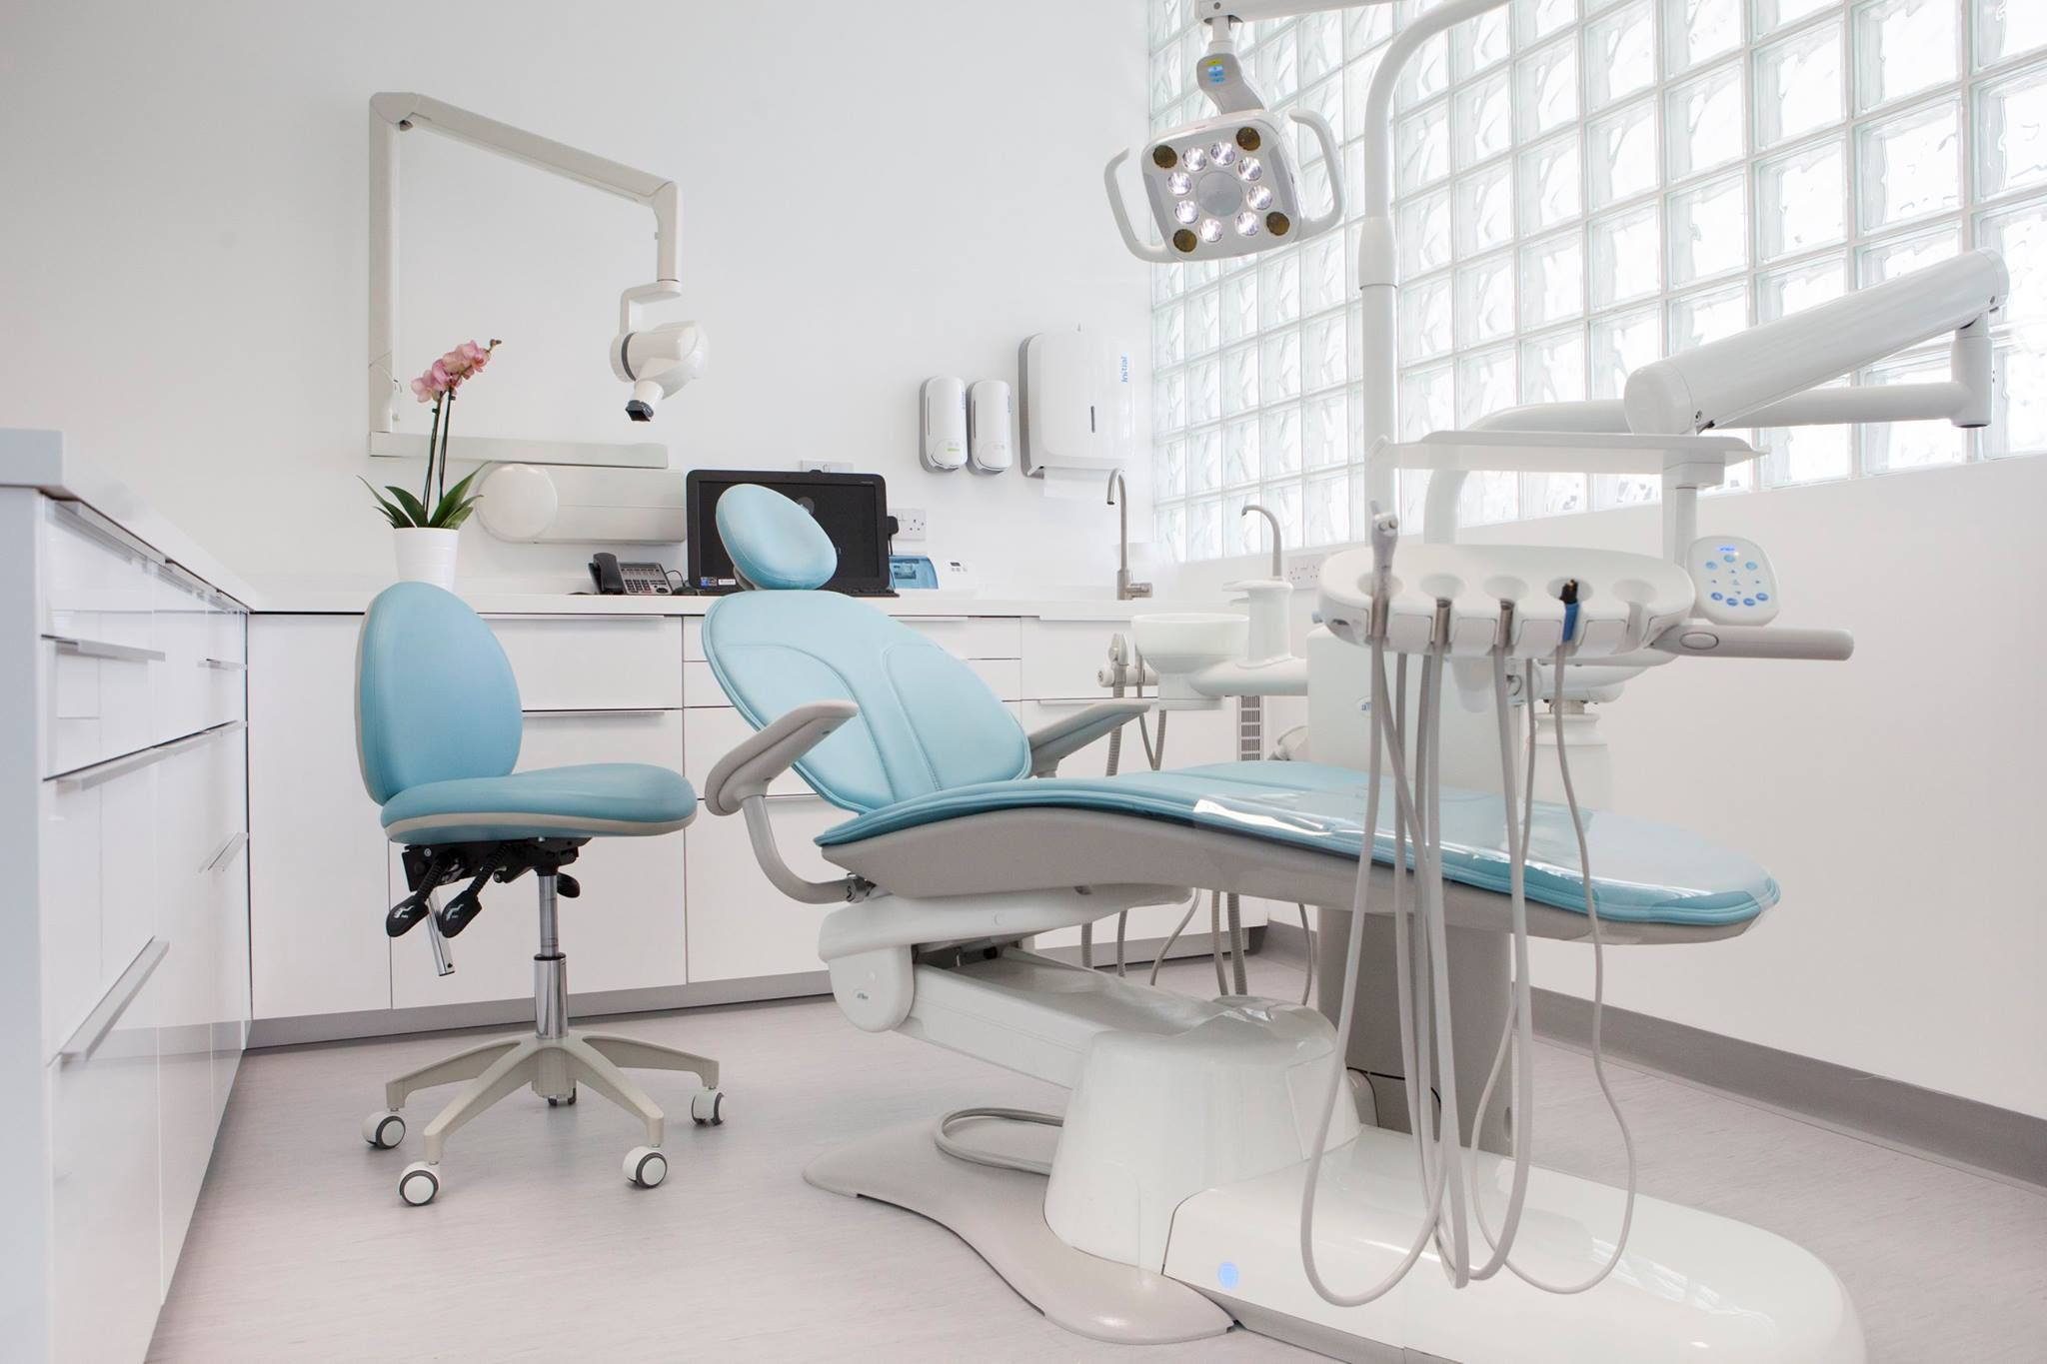

Slide 24
FIXTURES DISPENSERS AND WASTE DROPS
Fixtures that require minimal hand contact should be choosen.
Soap and lotion dispensers can be sensor activated or foot or arm operated
VENTILATION
Work areas must have positive ventilation system.
Ventilation systems must prevent recirculation of contaminated air.
A properly designed ventilation system provides for minimum outside air-flow rate of 20 CFM (cubic feet per minute)
Filters for heating, ventilation and air-conditioning systems

Slide 25
PROCEDURE SPECIFIC GUIDE LINES
Examinatio n
Restorative procedures
Endodontic procedures

Slide 26
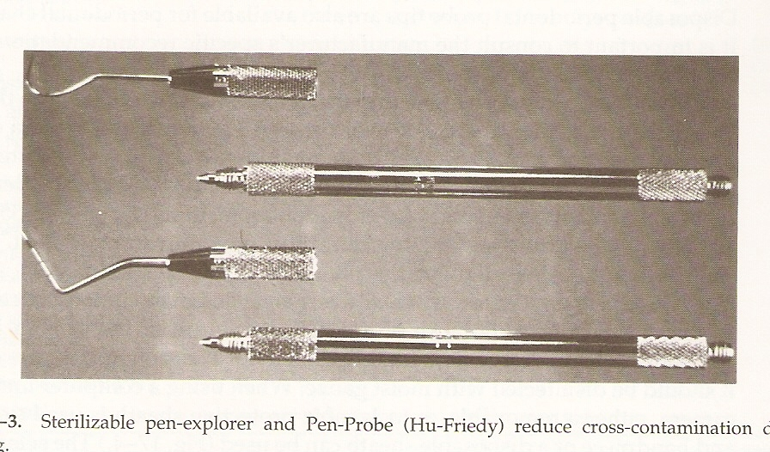
INFECTION CONTROL DURING EXAMINATION PROCEDURES
Sterilized examination instruments and sterilized air water syringe tip should be available
Infection control management of patient record is a challenge particularly during charting procedures.

Slide 27
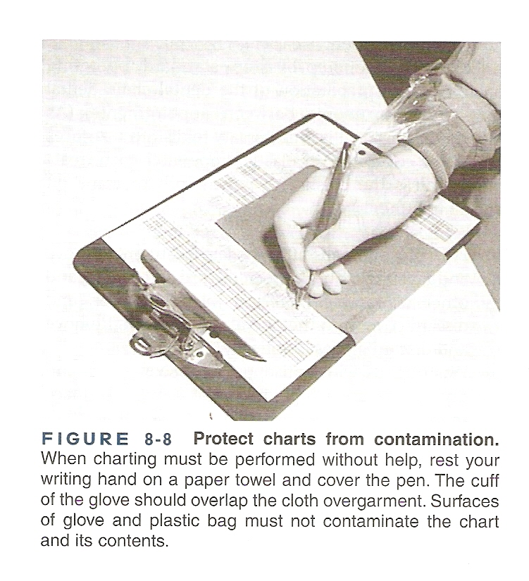
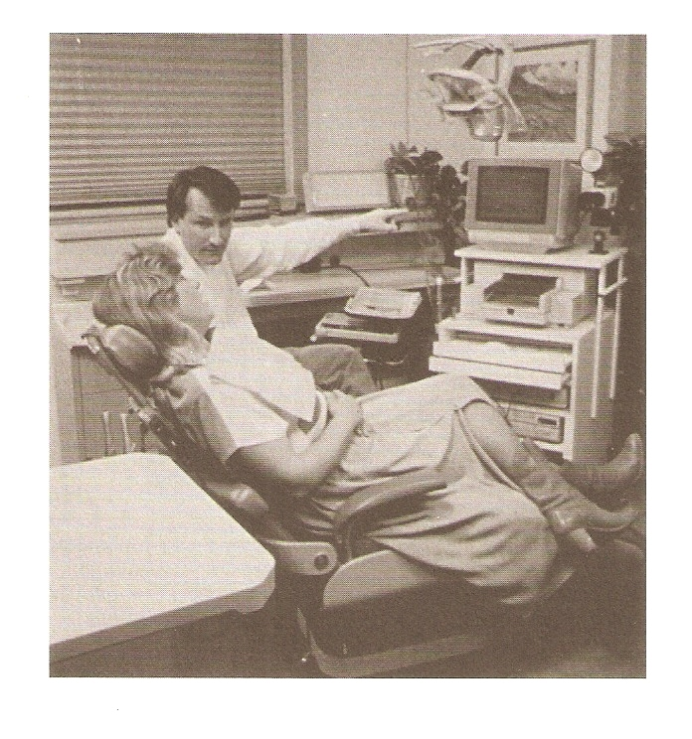
CHARTING
Barrier between chart & gloved hand
Computerized charting

Slide 28
INFECTION CONTROL IN RESTORATIVE PROCEDURES
Organizing the instruments &Instrument setups
Rubber dam reduces bacterial counts in combination with high speed evacuation
Curing lights with attached UV light shields require fresh barriers between patients to prevent cross contamination.
Amalgamator is non-critical over gloves should be worn when touching the equipment during patient treatment.

Slide 29
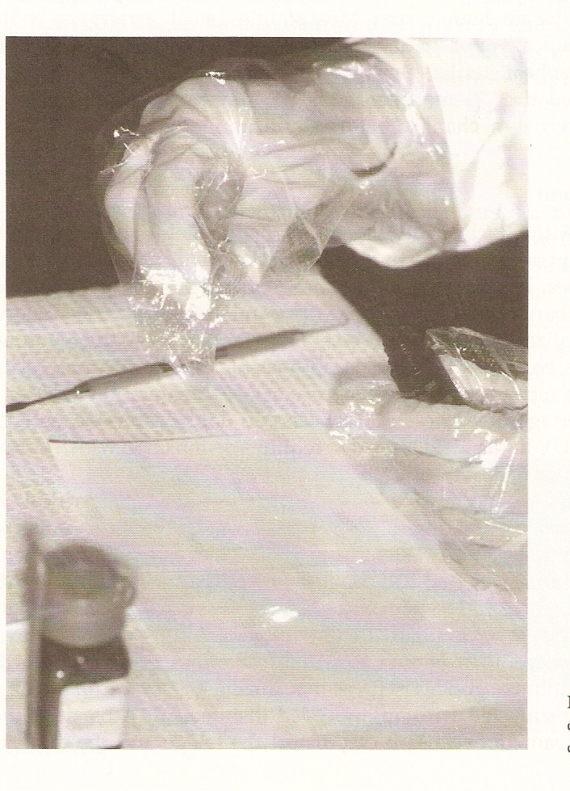
DENTAL MATERIALS
Unit dose dispensing of materials
Over glove when handling individual containers

Slide 30
Metal instruments - autoclaved or dry heated or chemically sterilized.
Dry heat and ethyleneoxide sterilization are least damaging to burs
Endodontic files are more compatible with dry heat sterilization.
Stainless steel instruments such as endodontic pluggers should be heat sterilized
Equipment such as electric pulp testers irrigating units and apex locators. Their components should be heat sterilized when possible or disinfected

Slide 31
MANDATED INFECTION CONTROL PROGRAM
Use of personal protective equipment
Surface decontamination
Effective hand washing
Immunization of health care workers
Effective record keeping

Slide 32
Cleaning Of Instruments
Instrument cleaning is the very first and important step in sterilization process.
CDC states that cleaning is the first step of all decontamination.
Endodontic instruments present a unique challenge because of their flutes and spirals

Slide 33
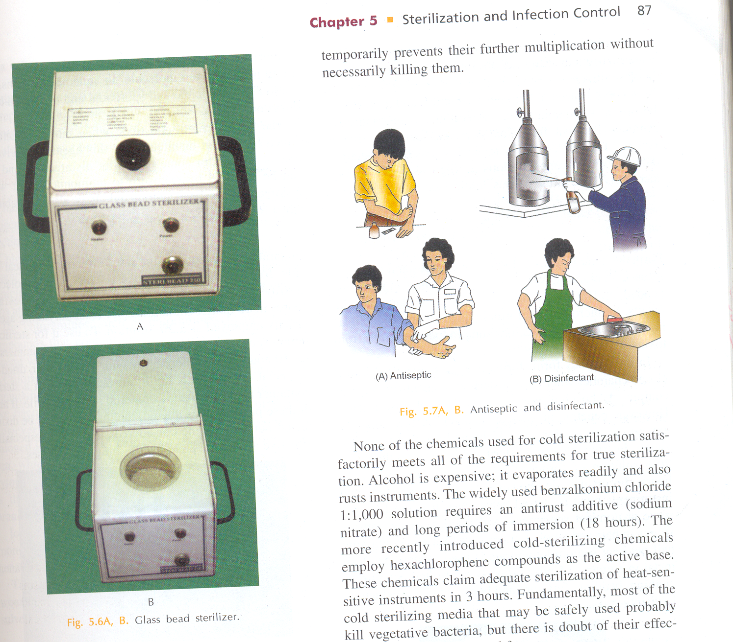
Sterilisation of endodontic instruments
Temperature between 425°F(218°C) and 475°F(246°C)
Broaches, files, silver cones and reamers sterilized in 5s
Absorbent points & cotton pellets in 10s

Slide 34
RUBBER DAM
Ray recommemded
2%-benzalkonium chloride in 50% isoproply alcohol.
Acc to Moller :swabbing with hydrogen peroxide followed by tincture of iodine.
Baumgartner : povidone iodine was as effective as 99% isopropyl alcohol.

Slide 35
Endodontic burs
Burs used for opening pulp chamber should be autoclaved .
Carbon steel burs should be sterilized in dry heat oven or chemical vapour or ethylene oxide .
In glass bead sterilizer :they are
kept for 15 sec.

Slide 36
Root canal instruments
BROCHES ,files ,reamers
They are either sterilized in hot salt or glass bead sterilizer (15 sec).
They can be sterilized in steam autoclave,dry heat oven ,chemical vapour and ethylene oxide.

Slide 37
Gutta percha
Immersing gutta percha in 5.25% sodium hypochloride for 1 min is very effective in killing microorganism and spore forms.(acc to cohen)
They can be sterile in screw capped vials containing alcohol.
To sterilize gutta percha cones freshly removed from the box we should immerse it in 5.25% sodium hypochorite ,then rinse with H2O2,then dry in b/w two layers of sterile gauge.

Slide 38
Hand piece
Cleaning
Leave the bur in place, during cleaning, to prevent contamination of the handpiece bearing.
Clean the outside with detergent and water – never clean or immerse the handpiece in disinfectant.
Lubricate the handpiece until clean oil appears.

Slide 39
CONCLUSION
The dental practitioner is challenged to implement effective infection control measures during all dental procedures in addition to using universal precautions
After renewing all the precautions and efforts employed to eliminate microbes during endodontic therapy, there is no safer procedure in dentistry than root canal therapy for either the patient or health care provider.

Slide 40
REFRENCES
Practical infection control in dentistry
Endodontic therapy –weine
Operative dentistry -sturdevant.
Infection control guidelines in dental practice.
Pathways of pulp –cohen
Ingle’s endodontics

Slide 41

Optimism is essential to achievement and it is also the foundation of courage and of true progress

Slide 42
Question & Answer Session
What is disinfection ?

Slide 43
references
Pathways Of The Pulp 6th Edn. & 8th Edn. Cohen
Endodontics Vol 1 Arnaldo Castellucci
Endodontics Ingle 5th Edn.
Colour atlas of Dental Medicine Endodontology
Rudolf Beer, Michael A. Baumann
Text book of Endodontology Bergenholtz Reitz
Endodontic Therapy Weine 5th Edition
Endodontics Vol 1 Arnaldo Castellucci
Color atlas of Endodontics William Johnson
Color Atlas of Endodontics – J.J.Messing & C.J.R Stock

Slide 44
THANK YOU

